Slide 1
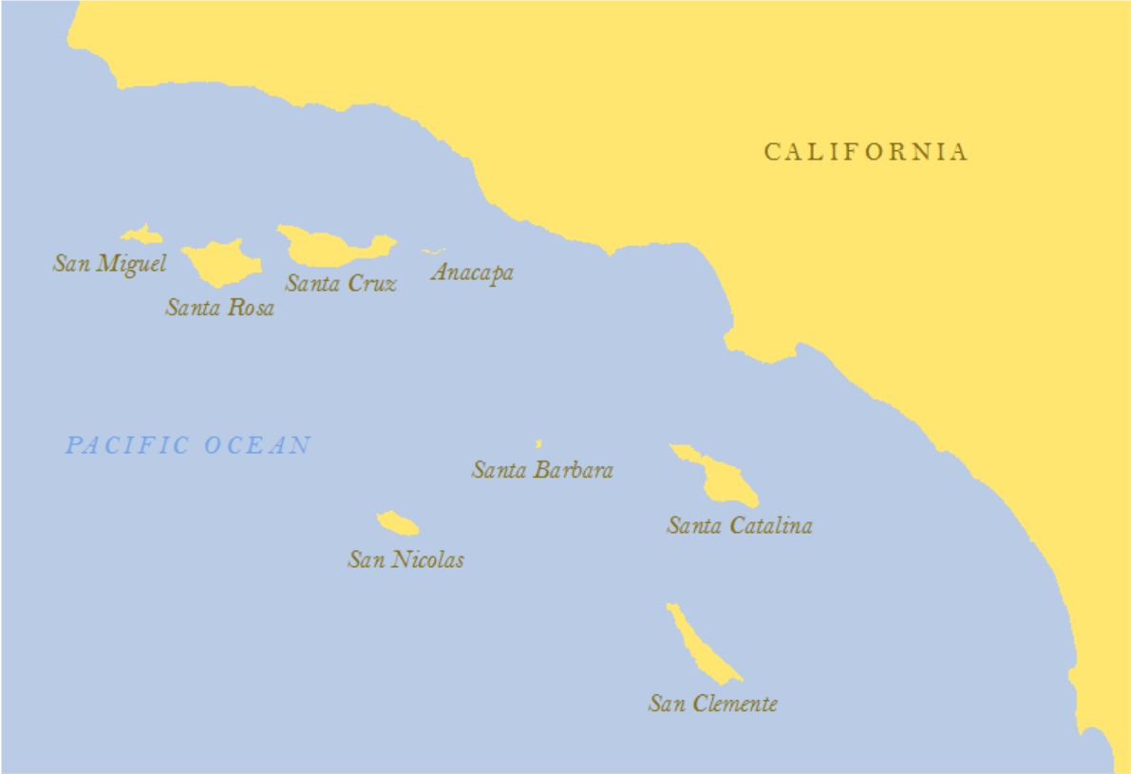
Coast of Southern California
25
km
Here’s a map of the coast of Southern California. It shows eight islands in the ocean, each a different distance away from the mainland.

Slide 2
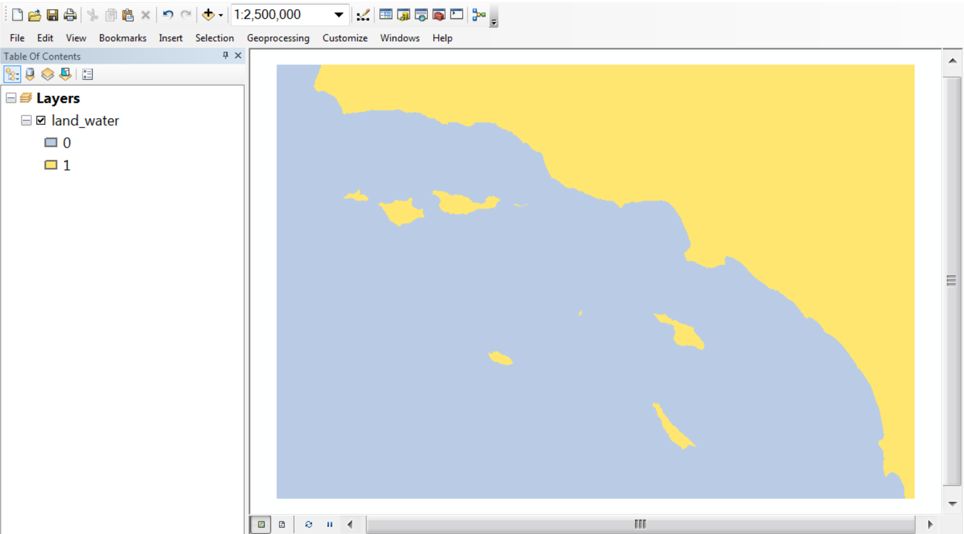
Geographic Information System (GIS)
In this tutorial, we’ll explore how you can use a computer software system called a Geographic Information System, or GIS, to answer this question. You’ll learn how GIS tools process information on map layers. This is a picture of a map layer in a GIS that shows ocean as blue and land as gold. In the window on the left, you can see that the layer is called “land_water” and consists of two numbers, 0 or 1.

Slide 3
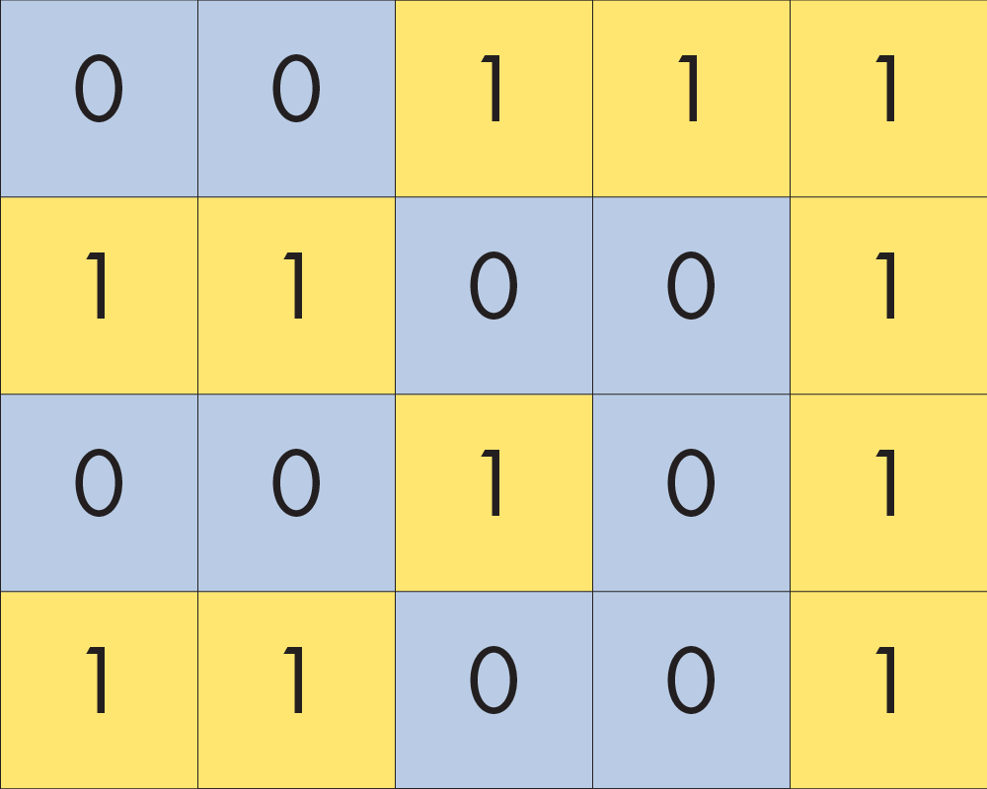
How a map layer works in a GIS
A grid of cells
Each cell must hold a number
Each number displayed with a color
Called a “Raster” Layer
Let’s use this simple example to look at how a map layer works in a GIS. A map layer is a grid of cells and each cell must hold a number. The GIS can display each number with a color. In technical jargon, this is called a “raster layer.” In this example, the raster contains two values, 0 or 1, and these values serve as codes to represent whether the location is ocean or land.

Slide 4
How a GIS processes information on map layers
use a layer
to make a new raster layer
with a
GIS TOOL
Input layer
Output layer
Now let’s look at how a GIS processes information on map layers. The general idea is that you will use a raster layer with a GIS tool in order to make a new raster layer. We’ll call the layer on the left the “input” layer and the layer on the right the “output” layer.

Slide 5
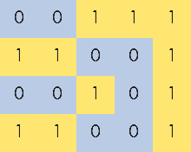
Tutorial will show you a four-step solution
Distance of each island from mainland
Ocean or land
Use four different GIS tools
1
2
3
4
This tutorial will show you a four-step solution for measuring the distance of each island from the mainland with a GIS. You’ll start with the layer of ocean or land. Then you’ll learn how to use four different GIS tools. The output of one tool will become the input of another tool. The last step will use two inputs to make a layer that tells us the distance of each island from the mainland. Let’s get started.

Slide 6
Step 1: identify separate regions of land
In the first step, our goal is to identify separate regions of land. We’ll start with this layer that just distinguishes between ocean and land. In the next slide, watch how the numbers change.

Slide 7
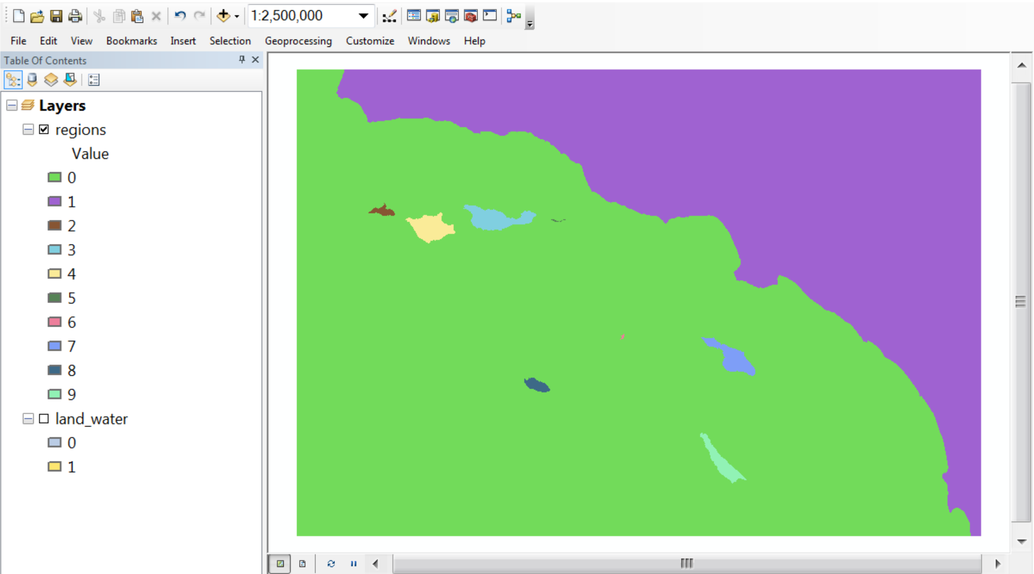
Step 1: identify separate regions of land
OK, the ocean is now green and that looks weird, but the colors were picked automatically by the GIS and so they’re arbitrary. Let’s focus on how the numbers changed. The ocean is still 0 and the mainland is 1, but each island now has a unique number.

Slide 8
How REGION GROUP works
Input layer
Output layer
Rules to group together cells:
Ignore any cell with value 0
Group if cells have same value and share a side
Do not group if cells have same value and touch only on a corner
The tool we used is called REGION GROUP. It uses rules to group together cells based on their value and their relationship to neighboring cells in the input layer. We’ll use three rules. First, we’ll ignore any cell with the value 0, because we want to leave ocean alone and only identify separate regions of land. Second, we’ll group cells with the same value if they share a side. Third, we won’t group cells with the same value if they touch only on corners.

Slide 9
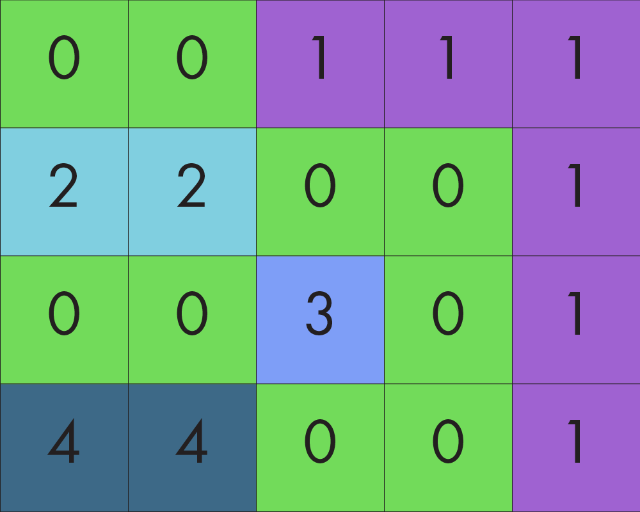
How REGION GROUP works
Input layer
Output layer
Rules to group together cells:
Ignore any cell with value 0
Group if cells have same value and share a side
Do not group if cells have same value and touch only on a corner
Here’s what the output layer would like with these rules. Since we ignored ocean cells, any cell that was a 0 in the input layer will remain a 0 in the output layer. We group together cells if they share a side, but don’t group together cells if they only share a corner. Each separate group gets identified by a unique number.

Slide 10
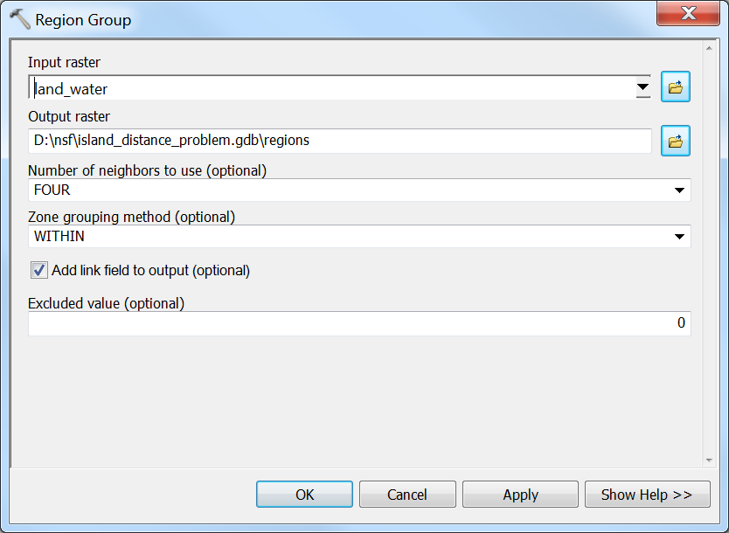
How to use the REGION GROUP tool
This is what the window looks like to interact with the REGION GROUP tool. I’ve already filled it out with all the information it needs to make the output layer we want. Of the six prompts in the window, there are only four that we need to focus on.

Slide 11
How to use the REGION GROUP tool
1. Input layer to use
2. Output layer to make
3. Group cells that share sides but not corners
4. Ignore cells with the number 0
First, we identify the input layer to use. Second, we identify the new layer to make and where to store it on the computer. Third, we tell the tool to group together cells that share sides (based on FOUR neighbors) and not cells that share sides or corners (which would be based on EIGHT neighbors). Fourth, we tell the tool to ignore cells with the number 0, so we leave ocean cells alone. The other prompts we can ignore.

Slide 12
Step 2: isolate the mainland
So now that we have this layer, our goal is to isolate just the mainland. Watch how the numbers change in the next slide.

Slide 13
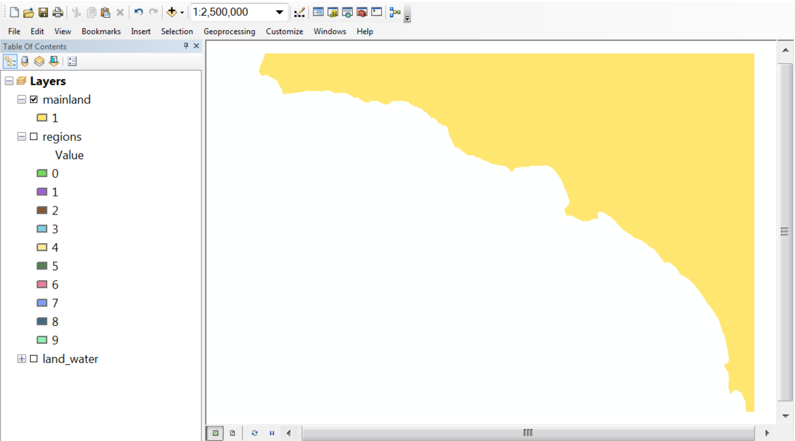
Step 2: isolate the mainland
The color used to display the mainland changed, but again, the colors are arbitrary. Importantly, the value for the mainland did not change. It’s still 1. But notice what happened to the other numbers. They don’t seem to be there anymore. The tool we used somehow erased them.

Slide 14
How RECLASSIFY works
Input layer
Output layer
The tool is called RECLASSIFY. Let’s look at how it works with our simple case. Using the raster on the left as our input layer, here’s what the layer on the right would look like if we only kept the value 1.

Slide 15
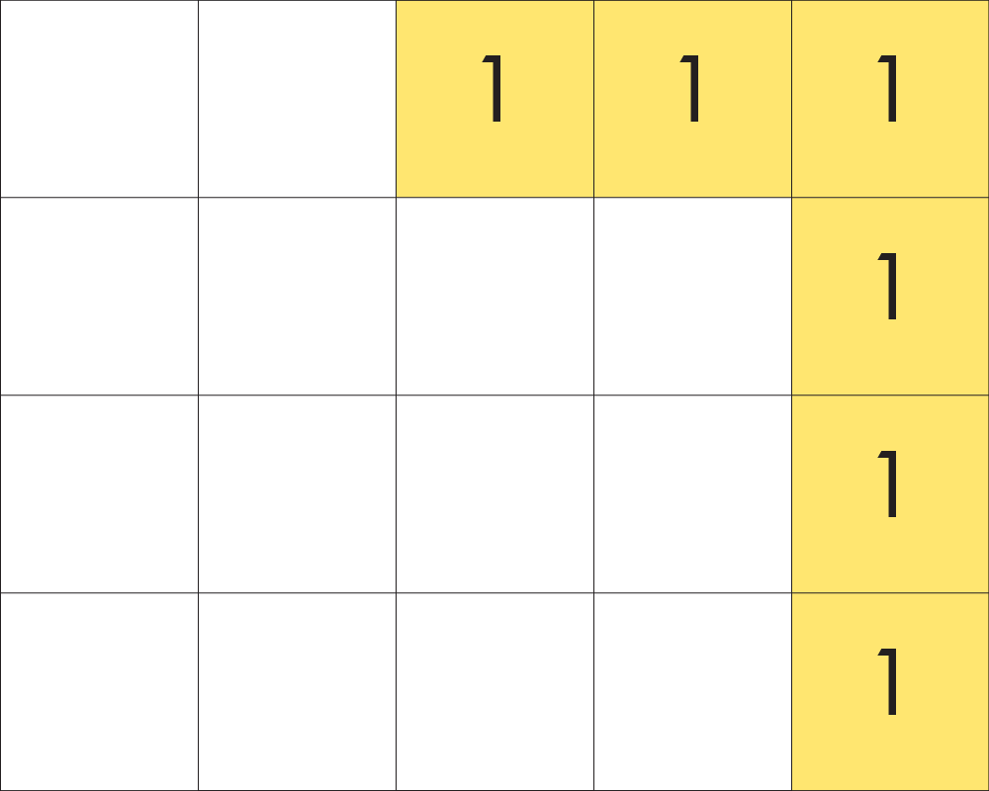
How RECLASSIFY works
Input layer
Output layer
To start it seems pretty simple. We keep the value 1 and erase everything else. But we can’t just leave the raster like this, because every cell in a raster must store a value. We can’t have empty cells. We need a value to basically represent “nothing,” or the absence of something.

Slide 16
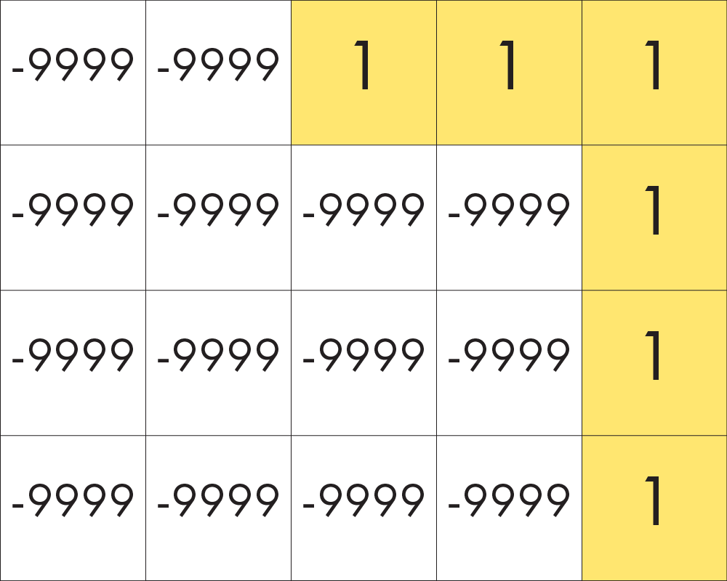
How RECLASSIFY works
Input layer
Output layer
“-9999” code for “nothing”, or “NoData”
So you probably didn’t see this coming, but the GIS uses a code to represent “nothing.” The code happens to be -9999, but the GIS won’t treat this code as a number. It recognizes -9999 as standing for the absence of a number, or what the GIS calls “NoData.”

Slide 17
How RECLASSIFY works
Input layer
Output layer
Old values
New values
“-9999” code for “nothing”, or “NoData”
Now we just need a way to give the GIS instructions for changing some values and not changing others. Let’s get organized with a table. The first column defines the values or ranges of values in the first layer and the second column defines new values you want to give these cells in the new layer.

Slide 18
How RECLASSIFY works
Input layer
Output layer
Old values
New values
0
2 - 4
NoData
NoData
“-9999” code for “nothing”, or “NoData”
We want to change the value “0” in the first layer into the code for NoData, but rather than typing in “-9999” we actually need to write out “NoData” without spaces and with the N and D capitalized. That’s just the way the GIS likes it. Then we also want to take the values that are greater than or equal to 2 and less than or equal to 4 and make them NoData. We can do this by writing out the range “2 – 4”. Finally, we don’t need to include “1” in the table because we don’t want that value to change in the output layer.

Slide 19
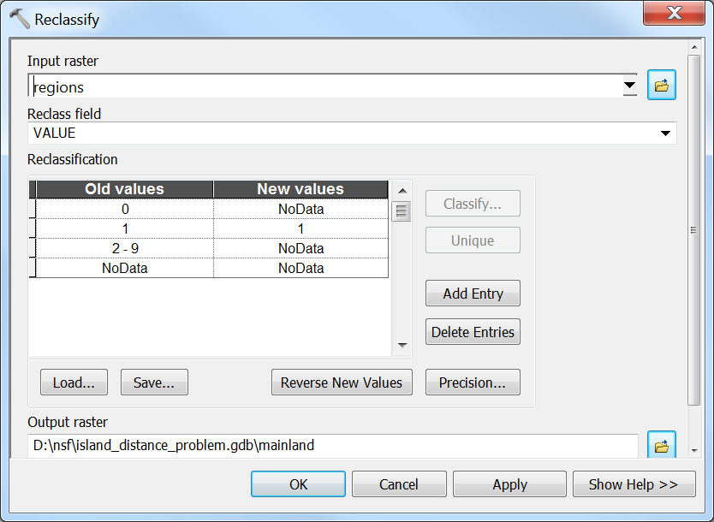
How to operate RECLASSIFY Tool
Here’s the dialogue window for the RECLASSIFY tool. I’ve already filled out the three key prompts. There are three prompts we need to focus on.

Slide 20
How to operate RECLASSIFY Tool
1. Layer to start with
2. The numbers or ranges of numbers to change and what to change them into
3. Name of new layer and where to save it
The first identifies the layer to start with. The second gives instructions on the numbers or range of numbers to change and what to change them into. The third gives the name of the output and where to save it on the computer.

Slide 21
Step 3: Calculate distance from the mainland
So that got us this layer. Perhaps you’re wondering why we needed to make this. Well, we want to make a new layer that tells us how far away every cell in the layer is from the mainland. Look closely at the values in the raster and how they change in the next slide.

Slide 22
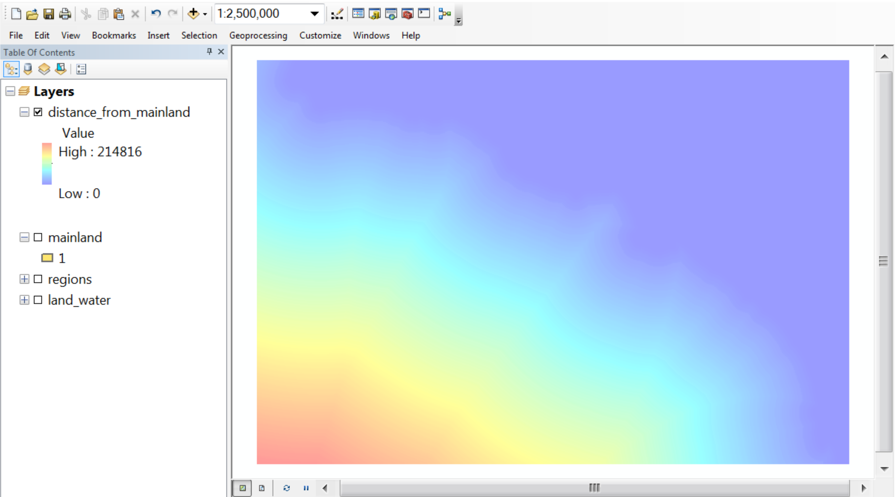
Step 3: Calculate distance from the mainland
You can still faintly see the mainland as the dark blue shape because the dark blue represents a distance of 0. As you move away from the mainland, the colors change from blue to red. This represents increasing distance, or larger numbers.

Slide 23
How EUCLIDEAN DISTANCE works
Input layer
Output layer
For every cell, what is the distance from this cell to the nearest cell that holds a number?
The tool is called EUCLIDEAN DISTANCE. Let’s look at our simple example again. The tool basically asks this question: for every cell in the new layer, what is the distance from this cell to the nearest cell that holds a number in the old layer? So let’s start with the cells in the input layer that hold a number.

Slide 24
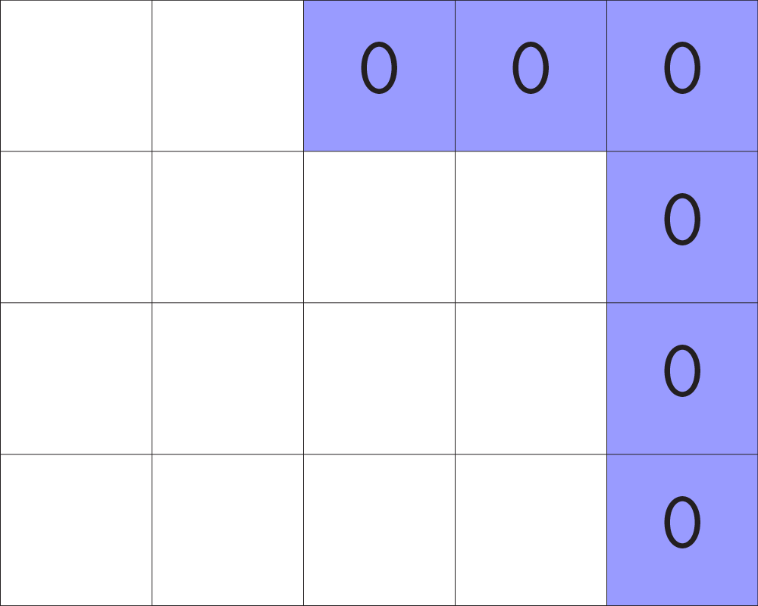
How EUCLIDEAN DISTANCE works
Input layer
Output layer
Any cell with a number value =
zero distance from itself.
Any cell in the input layer with a number value will have the distance 0 in the new layer, because it is zero distance away from itself. If we ask, how far away are we from the mainland? And we’re standing on the mainland, then we’re 0 distance away. Now let’s look at cells that have NoData in the input layer and share one or more sides with the mainland.

Slide 25
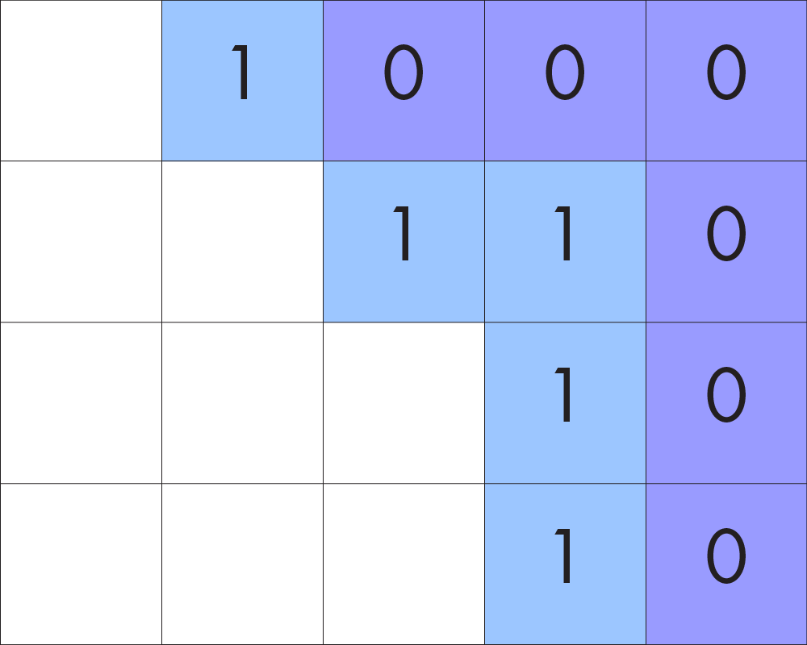
How EUCLIDEAN DISTANCE works
Input layer
Output layer
Any cell with NoData and shares one or more sides with a cell that holds a value =
One cell away.
In the output layer, these cells get the value “1” because in the input layer each of these cells are NoData and share a side with one or more cells that have a number value. In other words, they are 1 cell away from a cell with a number in the input layer. Now let’s look at what happens on diagonals, when a cell with NoData shares a corner with the mainland.

Slide 26
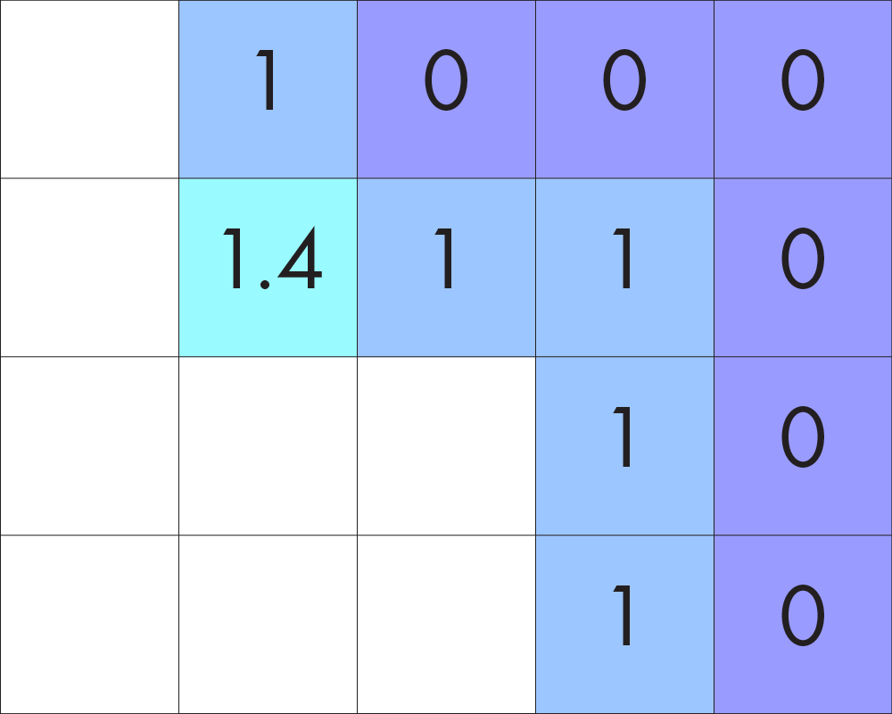
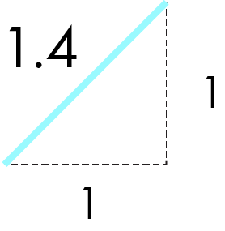
How EUCLIDEAN DISTANCE works
Input layer
Output layer
Cell with NoData and shares a corner with cell that holds a number value.
Use Pythagorean’s Theorem for diagonal distance.
Because diagonal distance on a grid is longer than horizontal or vertical distance, the tool will use Pythagorean’s Theorem to calculate distance for diagonals. In this case, the right triangle has two sides equal to 1, so the length of the hypotenuse is 1.4. Here’s what happens with the remaining cells.

Slide 27
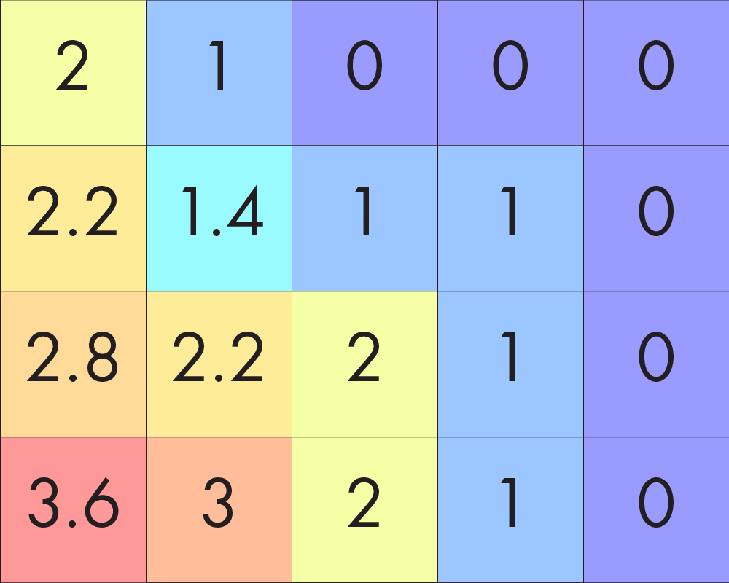
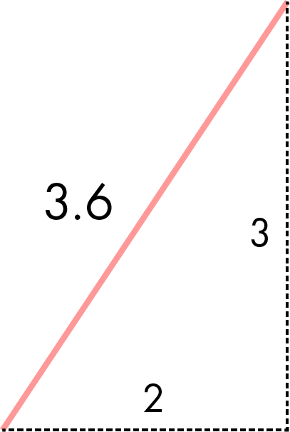
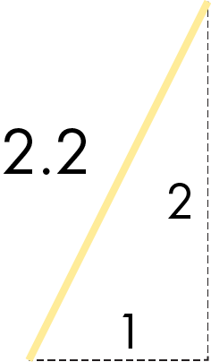
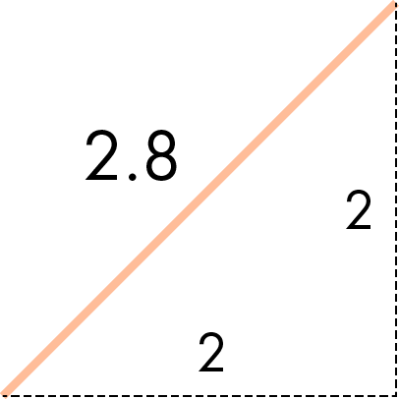
How EUCLIDEAN DISTANCE works
Input layer
Output layer
Cells with values “2” or “3” are nearest to the mainland in the horizontal or vertical direction. Cells with decimal values are nearest to the mainland diagonally and are calculated with Pythagorean’s Theorem. So we’re almost there but we haven’t established what units these numbers represent. We need to translate how many cells away something is into units of distance, like meters.

Slide 28
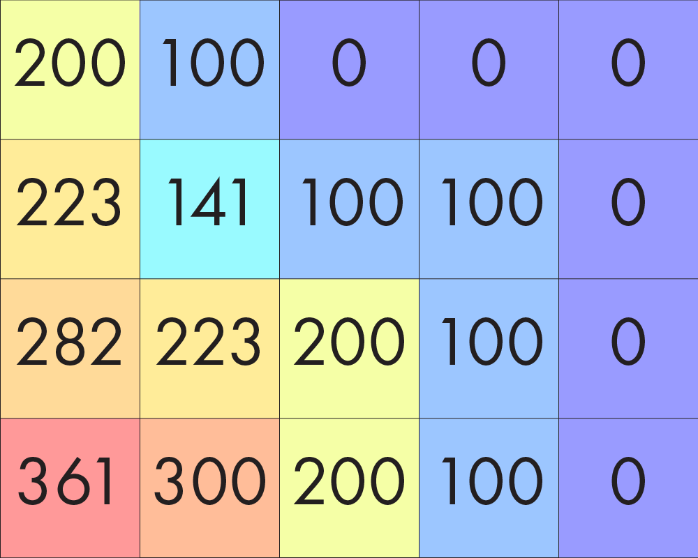
How EUCLIDEAN DISTANCE works
Input layer
Output layer
To do this, we just need to know the distance that each side of a raster cell represents. Then we can use this number to scale the cells. In our example, let’s say the cell size is 100 meters. We just multiply this number with the distance in cell units to calculate the geographic distance.

Slide 29
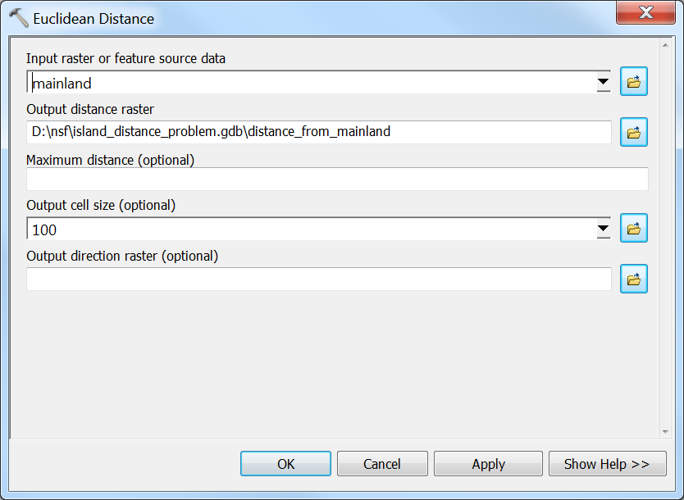
How to operate EUCLIDEAN DISTANCE Tool
Here’s the dialogue window for the EUCLIDEAN DISTANCE tool. I’ve filled out three prompts.

Slide 30
How to operate EUCLIDEAN DISTANCE Tool
1. Layer to start with.
2. Name of new layer and where to save it.
3. Cell size of input layer to scale cell distance.
The first tells the tool the name of the layer we’re starting with. The second tells the tool the name of the layer we’re making and where the tool should save it. The third tells the tool the cell size of the input layer in meters so it can scale the cell distance calculation.

Slide 31
Step 4: Find minimum distance from mainland within each island
So now we have this layer that tells us the distance of every location from the mainland. In our last step, we want to find the minimum distance from the mainland within each island. Look at how the values in the layer shown here change in the next slide.

Slide 32
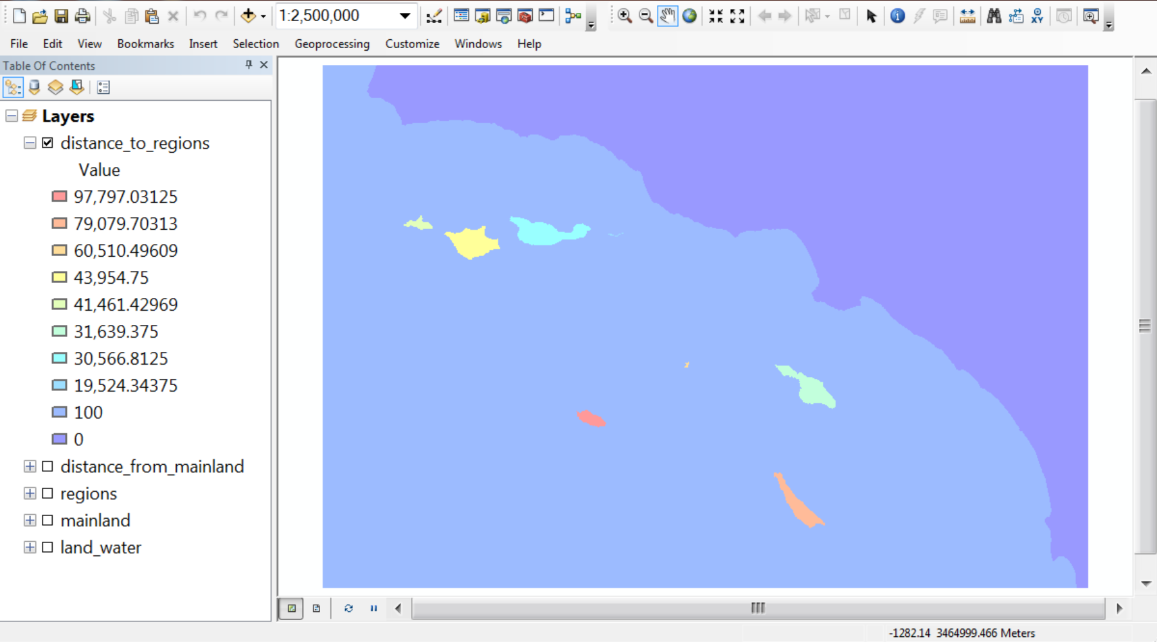
Step 4: Find minimum distance from mainland within each island
In this layer, we just have one value for each island. But we also have one value for the ocean and another value for the mainland. The tool that made this layer uses two input layers. So we need to use another layer along with the distance from the mainland layer to make the layer shown here.

Slide 33
Step 4: Find minimum distance from mainland within each island
We will use the layer we made in the first step that identifies each region with a unique number. This will let us make a new layer that tells us the minimum distance from the mainland within each unique region.

Slide 34
How ZONAL STATISTICS works
Layer with zones
Every number identifies a zone
Zones don’t have to touch
The tool we’ll use is called ZONAL STATISTICS and here’s how it works. We’ll start with this layer that uniquely identifies zones. Basically, every number value in the layer identifies a zone. Importantly, the cells don’t have to touch to define a zone.

Slide 35
How ZONAL STATISTICS works
Layer with zones
Every number identifies a zone
Zones don’t have to touch
Zones
0
1
2
3
4
Here is the list of values that define each zone. There are five zones. The first one is identified with 0. The last one is identified by 4.

Slide 36
How Zonal Statistics works
Input layer with zones
Input layer of values
Zones
0
1
2
3
4
Now let’s look at the second layer that provides the values we want to summarize within each zone. In this case, we want to use the distance layer. The GIS tool will focus on the values in this layer that are within each zone in the first layer.

Slide 37
How ZONAL STATISTICS works
Input layer with zones
Input layer of values
Zones
0
1
2
3
4
Values
100, 200, 223, 282
Here is the list of values in the right layer that are in Zone 0 in the left layer. If we just list the values once even if they appear many times, then there are four values in the right layer that are found within Zone 0 in the first layer.

Slide 38
How ZONAL STATISTICS works
Input layer with zones
Input layer of values
Zones
0
1
2
3
4
Values
100, 200, 223, 282
Statistic: Min
Output layer
The tool will let us choose a statistic to summarize the values in each zone. We’ll use “Minimum” as our statistic.

Slide 39
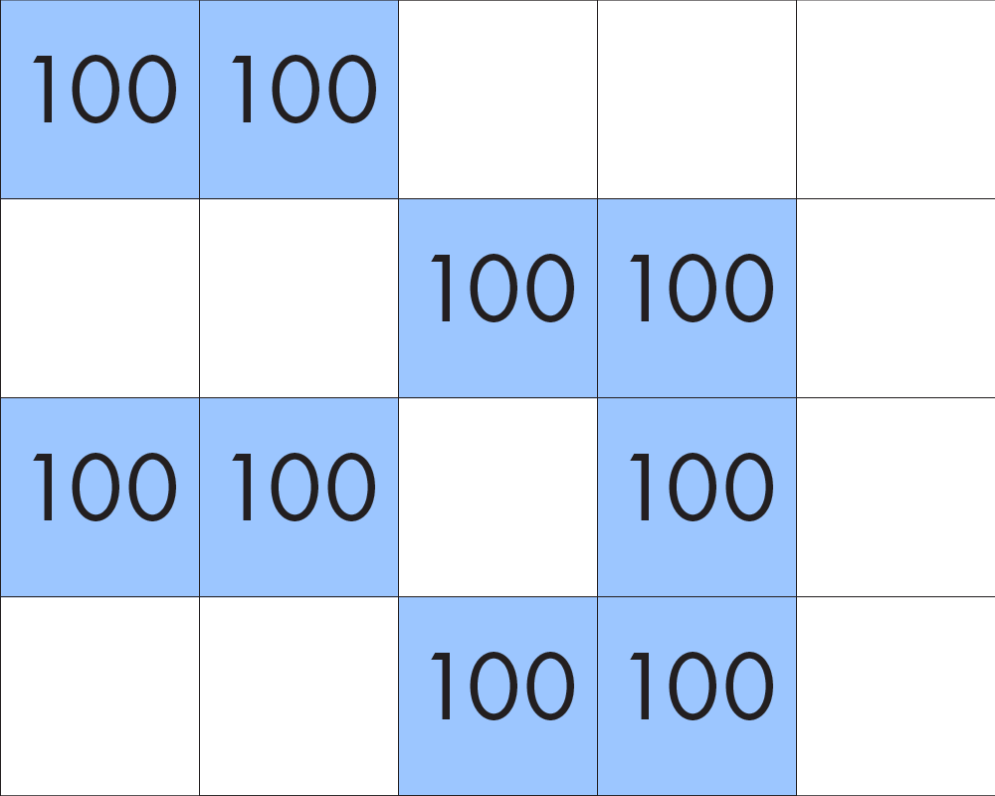
How ZONAL STATISTICS works
Input layer with zones
Input layer of values
Zones
0
1
2
3
4
Values
100, 200, 223, 282
Statistic: Min
100
Output layer
The output layer will store the minimum value in each cell of the output layer that corresponds to the zone. So for Zone 0, each cell would be the value “100.”

Slide 40
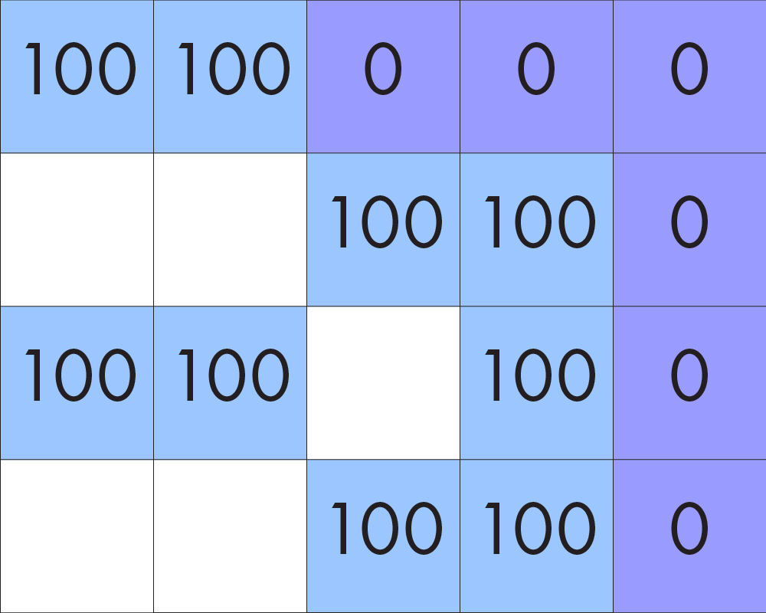
How ZONAL STATISTICS works
Input layer with zones
Input layer of values
Zones
0
1
2
3
4
Values
100, 200, 223, 282
0
Statistic: Min
100
0
Output layer
The output values for Zone 1 would look like this because the minimum distance in this zone is 0.

Slide 41
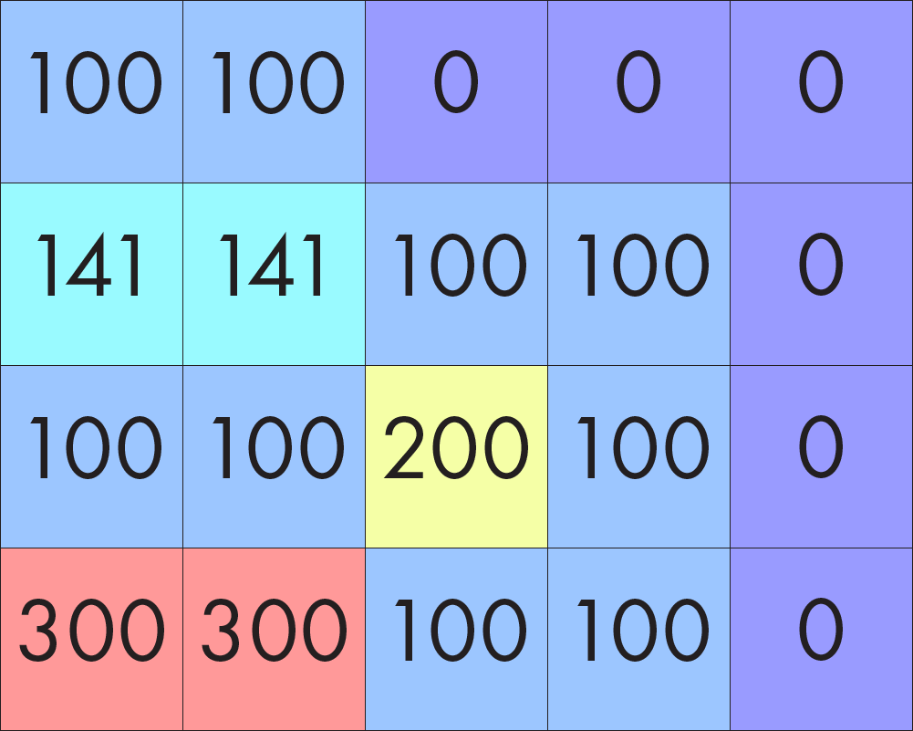
How ZONAL STATISTICS works
Input layer with zones
Input layer of values
Zones
0
1
2
3
4
Values
100, 200, 223, 282
0
141, 223
200
300, 361
Statistic: Min
100
0
141
200
300
Output layer
Here are the minimum values for the remaining cells. The minimum value is 141 in Zone 2, 200 in Zone 3, and 300 in Zone 4.

Slide 42
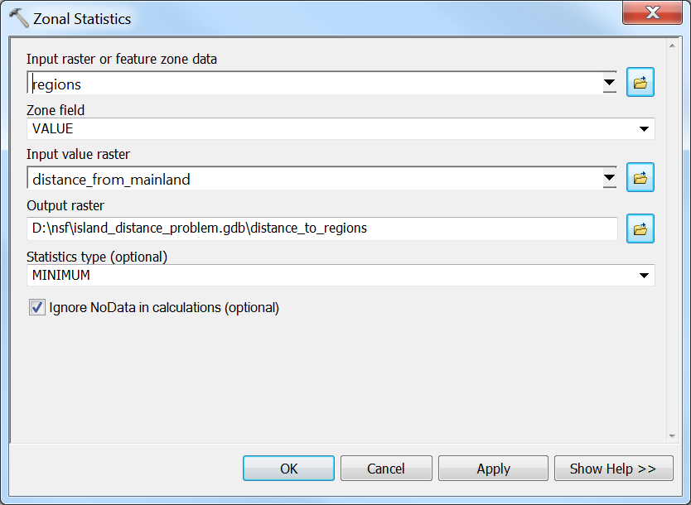
How to operate ZONAL STATISTICS Tool
Here’s the dialogue window for the ZONAL STATISTICS tool. I’ve filled out the four key prompts.

Slide 43
How to operate ZONAL STATISTICS Tool
1. Layer with zones
2. Layer with values
3. Output layer
4. Statistical summary
The first identifies the input layer with the zones. The second identifies the input layer with the values that we want to summarize with these zones. The third tell the tool the name of the output layer and where it should save it. The fourth identifies the type of statistical summary we’d like the tool to perform.

Slide 44
Distance of each island from the mainland
So here’s our final layer! It tells us the distance of each island from the mainland. The units are in meters, but you can see that the furthest island is a little less than 98 kilometers away while the nearest island is a little less than 20 kilometers away. Thanks for working through this tutorial! You’re all done!

